Slide 1
WELCOM ☺
INTRODUCTION

Slide 2
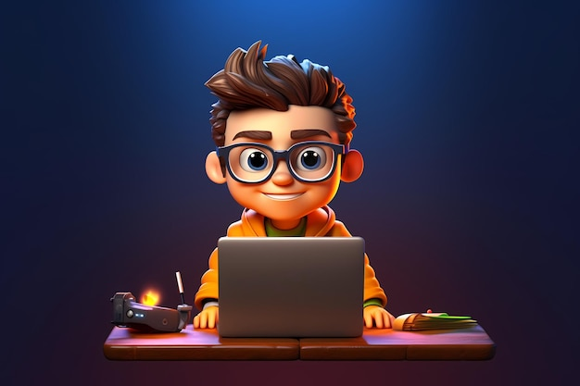
ABOUT ME:
- 4 YEARS OF SELF-THOUGHT LEARNING
- DOZENS OF PROJECTS
- PARTICIPATION IN OPEN-SOURCE PROJECTS

Slide 3




Slide 4
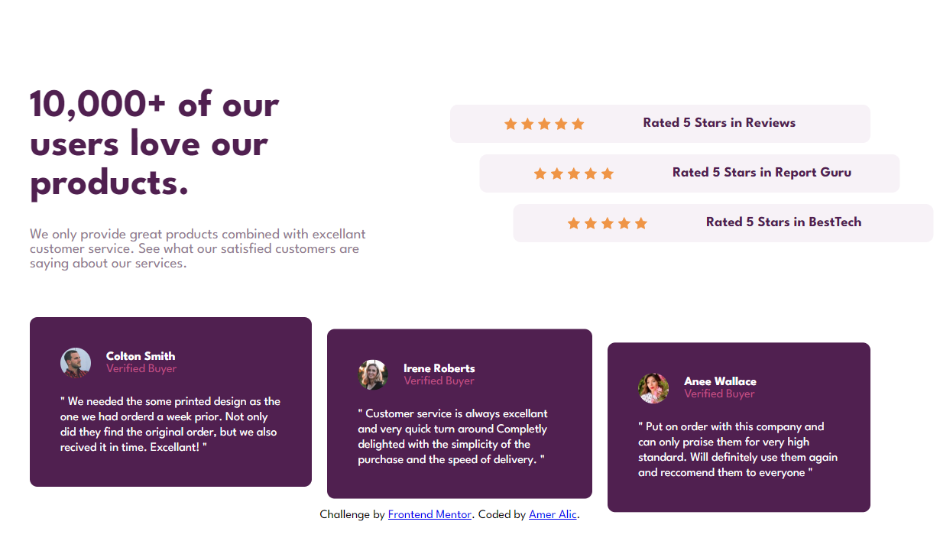
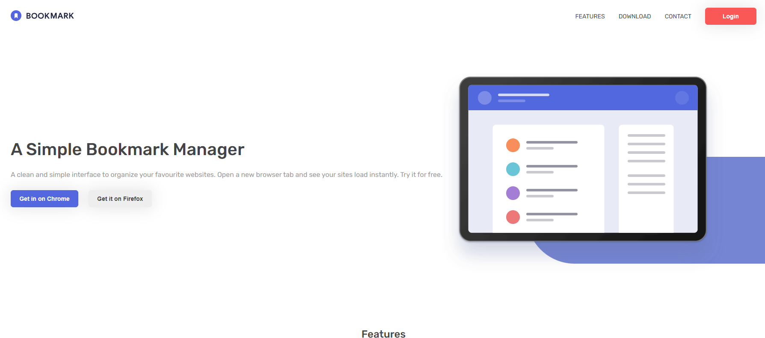
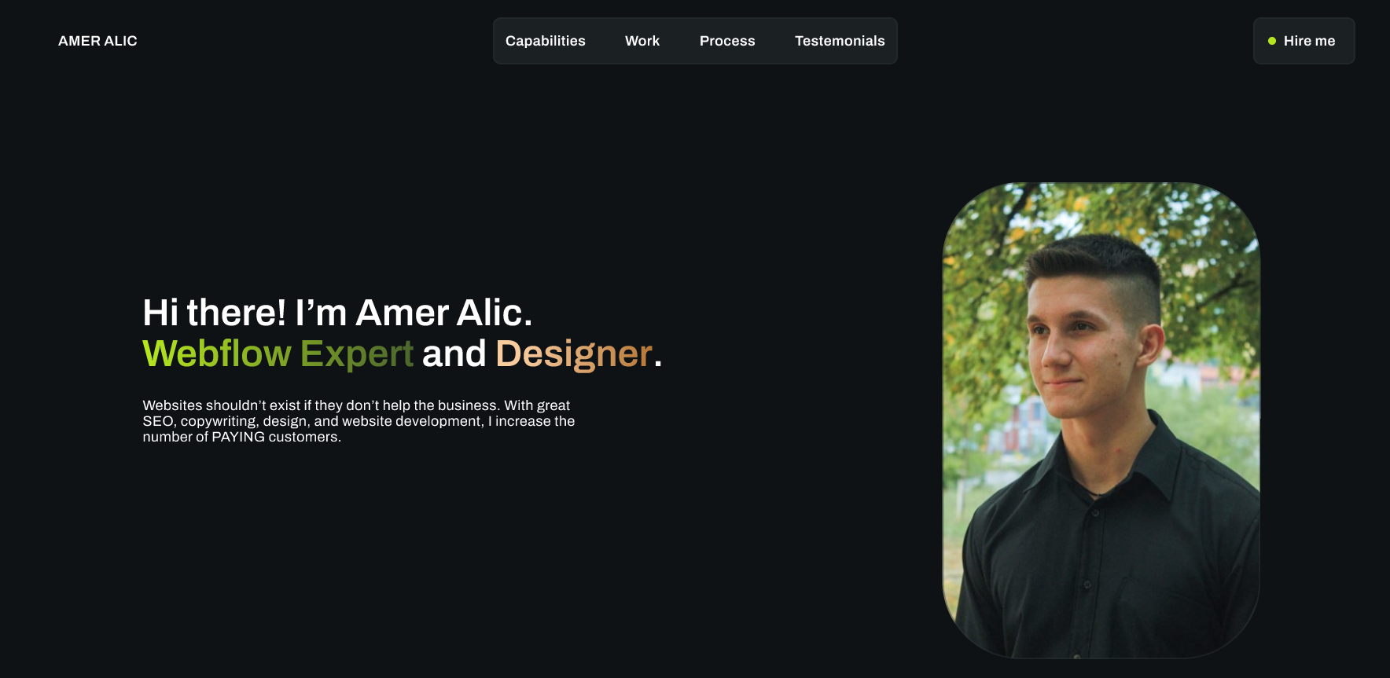
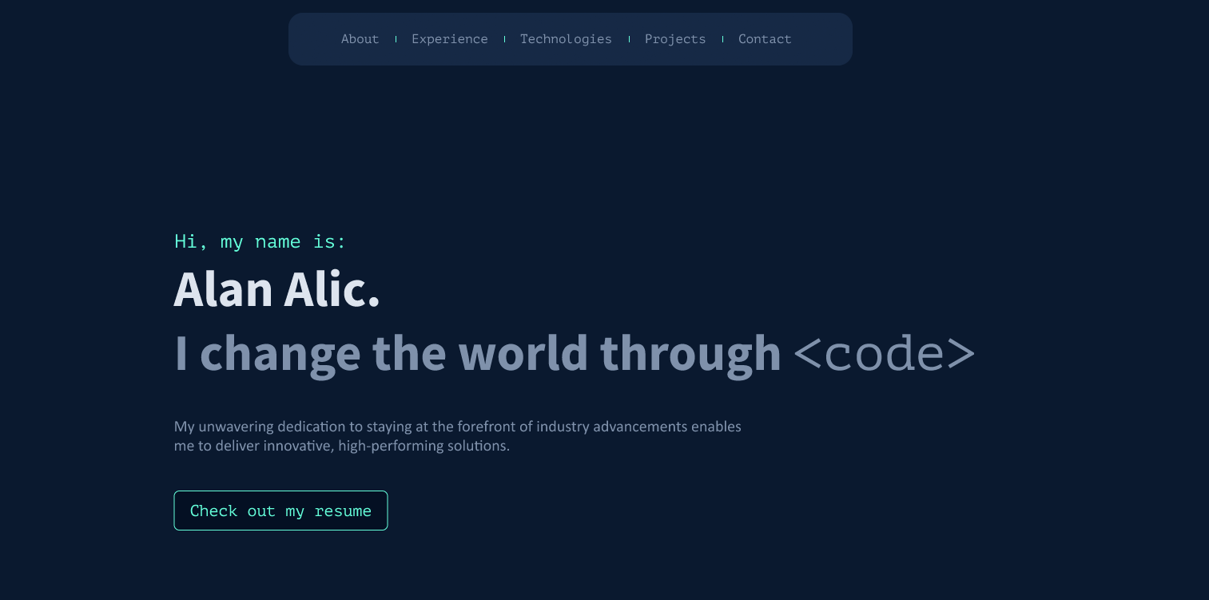
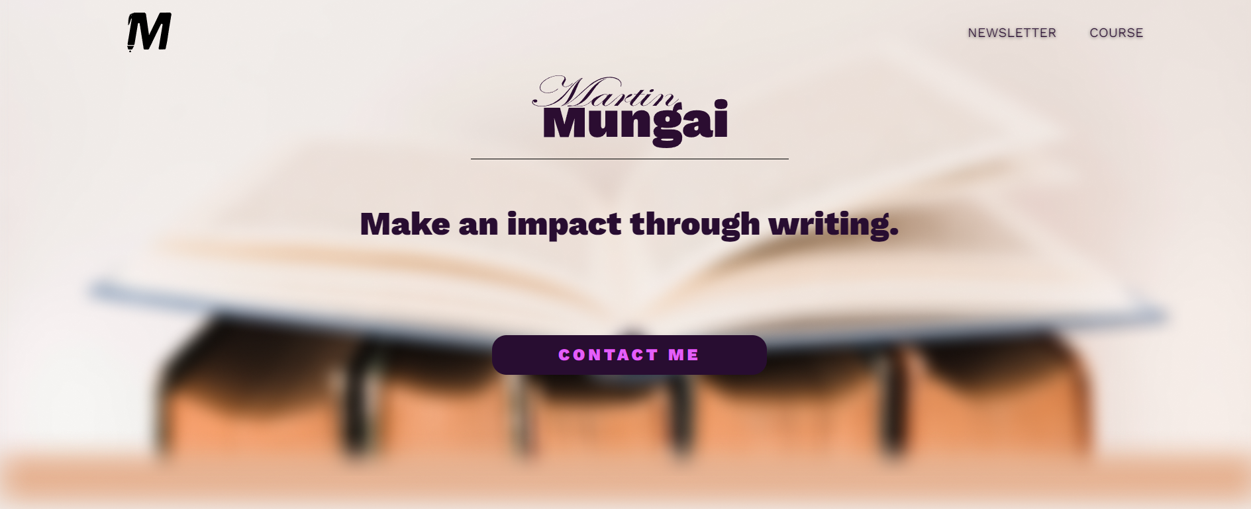

Slide 5
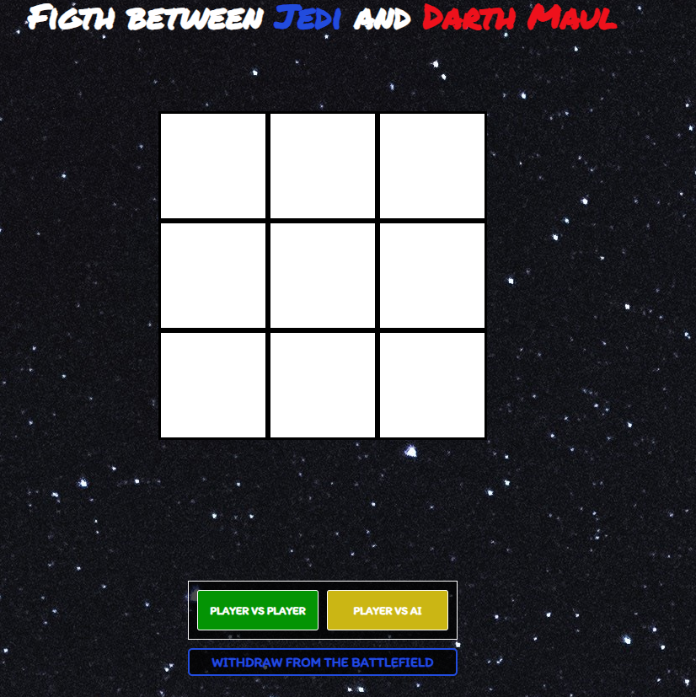
My favorite project:

Slide 6
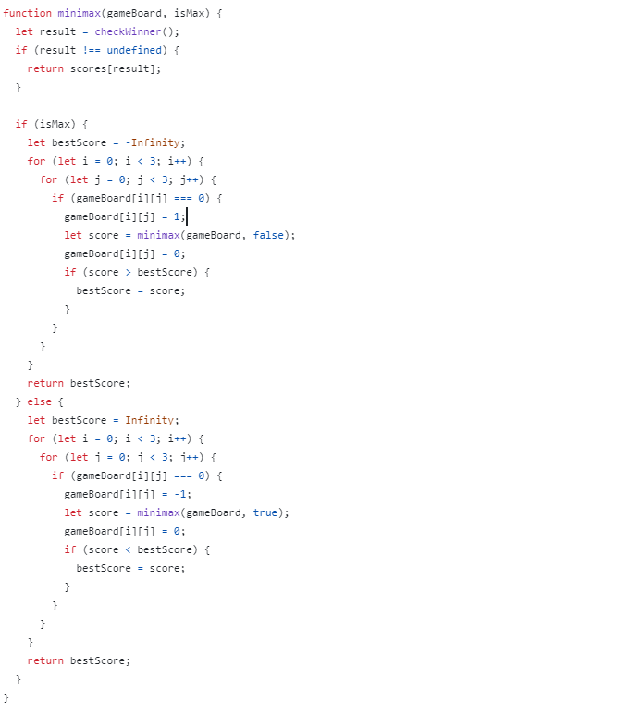
Why?

Slide 7
WHY AM I TELLING YOU THIS?

Slide 8
OTHER PROFESSORS

Slide 9
MEETING EACH OTHER

Slide 10
WHY WOULD YOU LEARN THIS?

Slide 11
— STEVE JOBS
“Everyone should know how to program a computer, because it teaches you how to think“

Slide 12
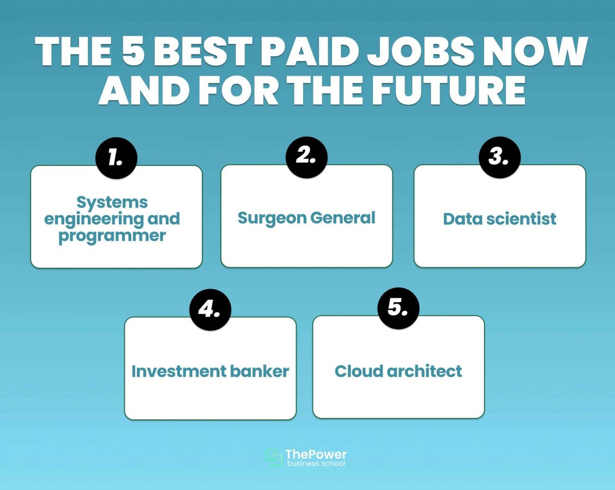

Slide 13
A meta-analysis of 440 studies found that learning computer programming visibly improves students' creativity, math skills, metacognition, spatial skills, and reasoning skills. In all analyzed studies, control groups were used, and the result in all 440 studies showed that students who were exposed to computer programming showed a "transfer" of their learning not only in the domain of informatics, but also to other skills such as creativity, mathematics and reasoning. "
source: semantic scholars (215,000,000 published articles)

Slide 14
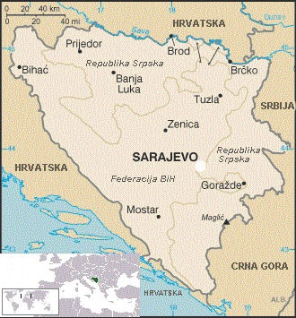
REASONS FOR US:

Slide 15
WHAT WILL YOU LEARN?

Slide 16
DIFFERENT TYPES OF WEB DEVELOPMENT
- FRONT END
- BACK END
- FULLSTACK

Slide 17
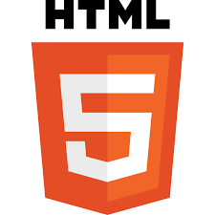
HTML:

Slide 18
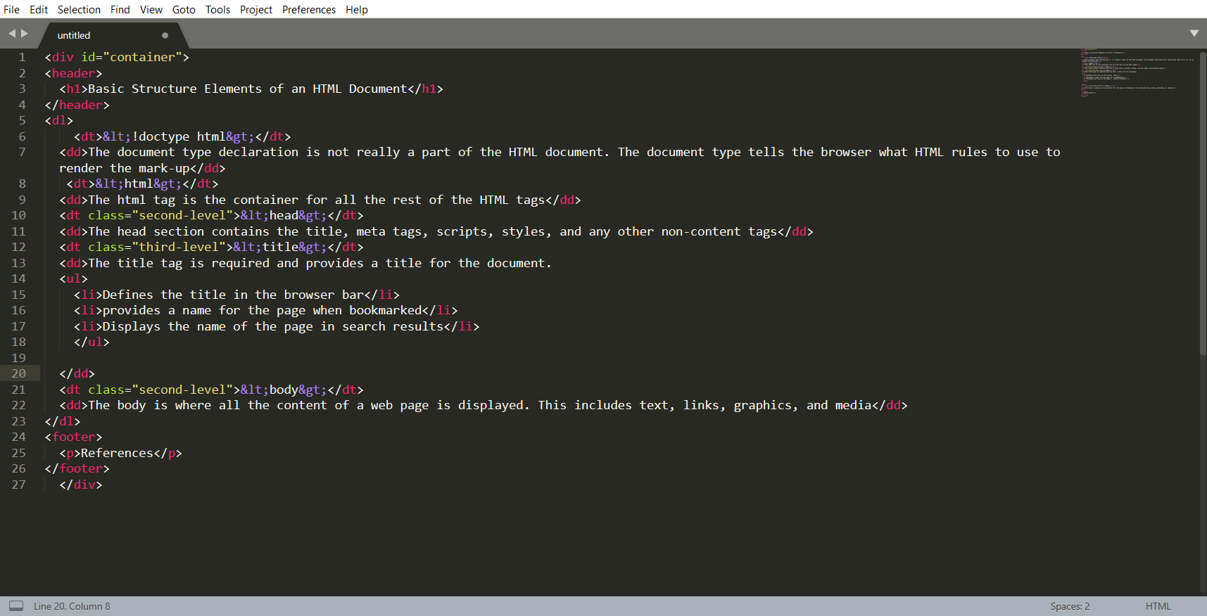
Creating your own structure and tags in HTML

Slide 19
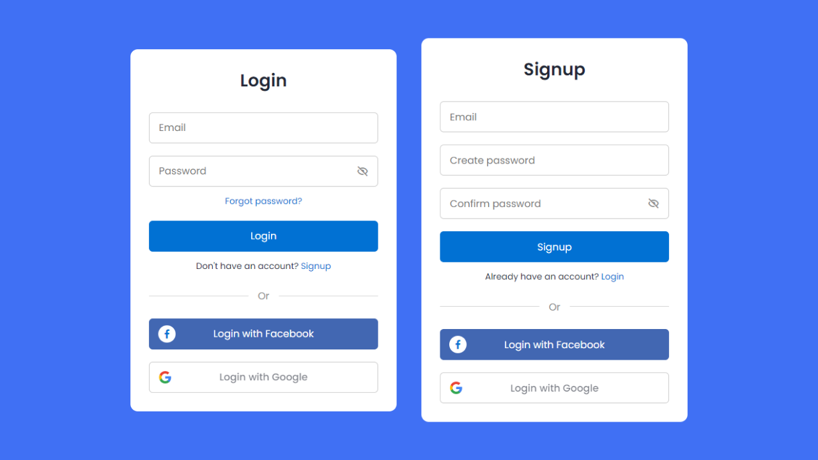
FORMS

Slide 20

CSS

Slide 21
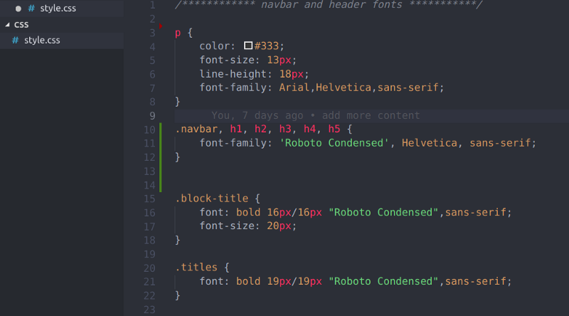
HOW TO USE TAGS IN CSS

Slide 22
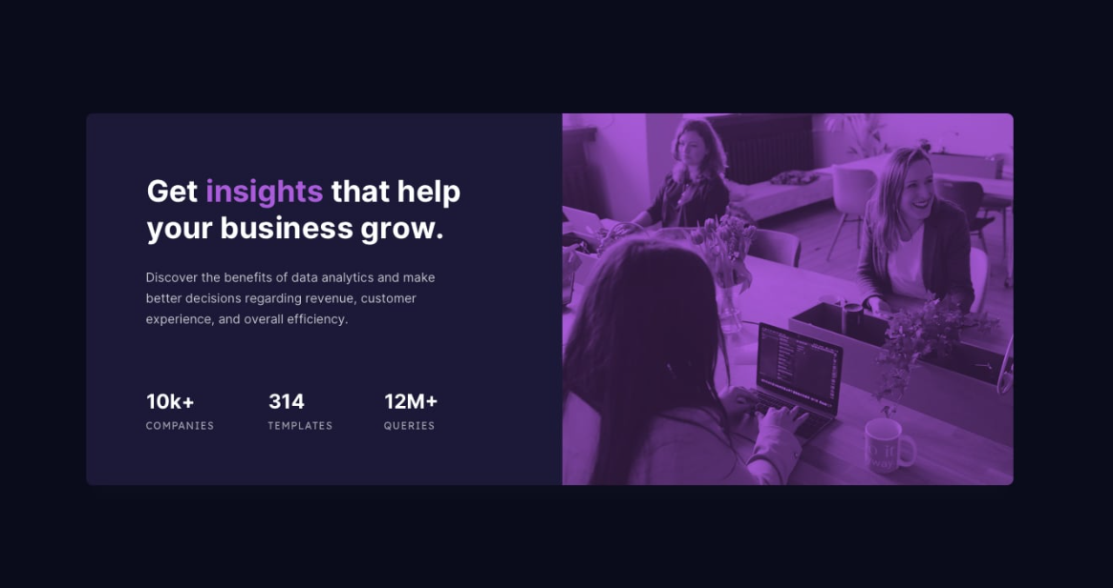
HOW TO GET THIS FROM HTML AND CSS:

Slide 23

JAVASCRIPT

Slide 24
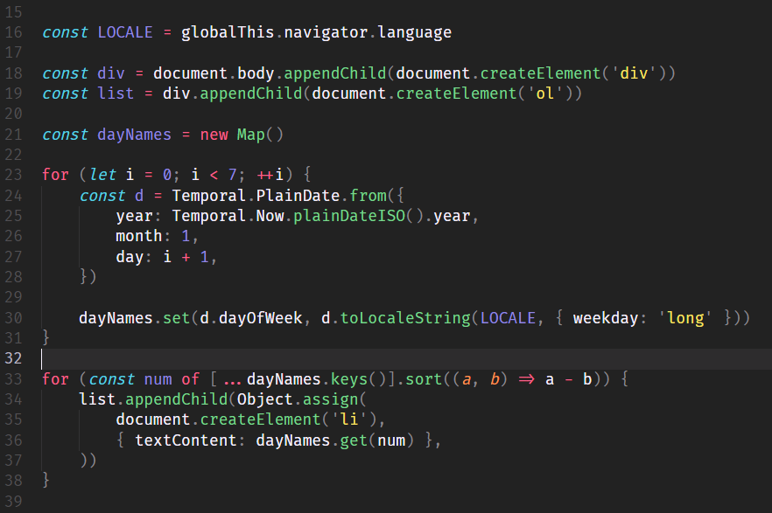
PROGRAMMING IN JS (JAVASCRIPT):

Slide 25
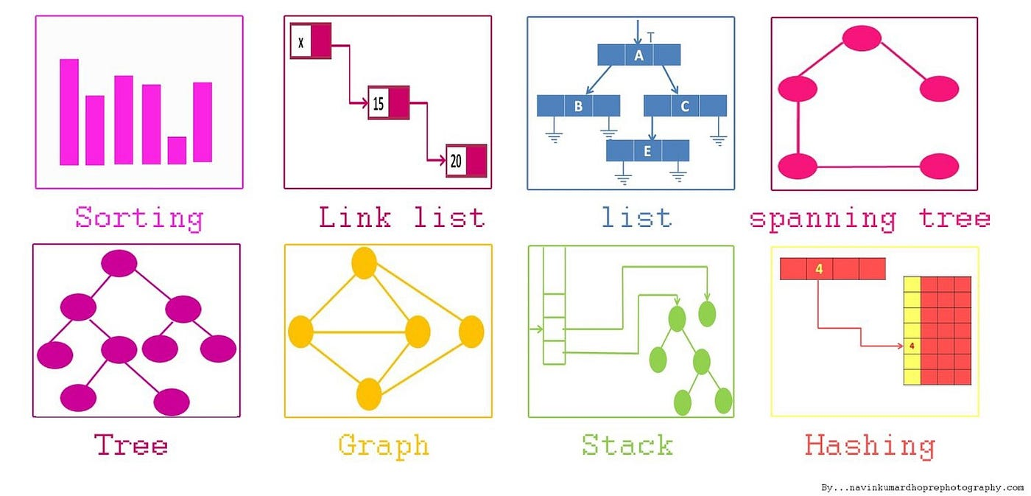
DATA STRUCTURES AND ALGORITHMS

Slide 26
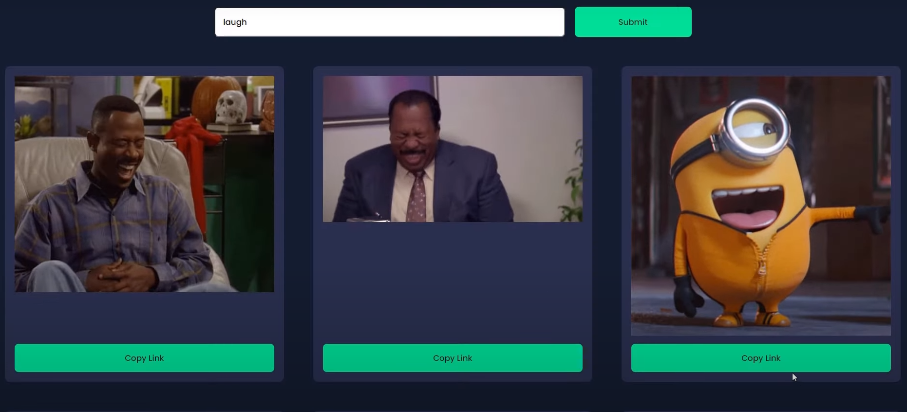
FINAL PROJECT

Slide 27
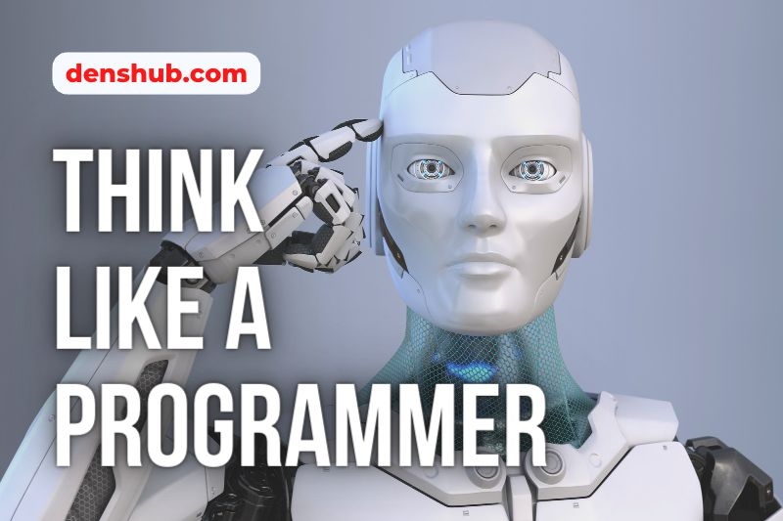
THINKING LIKE A PROGRAMMER:

Slide 28
BASIC CONCEPTS

Slide 29
1.KOMPJUTER

Slide 30
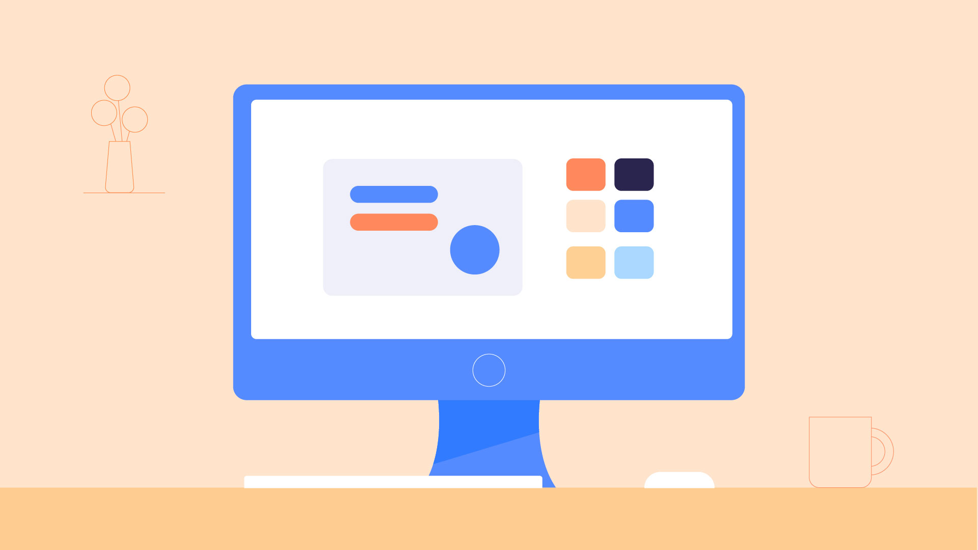
KOMPJUTER (LIČNI):

Slide 31
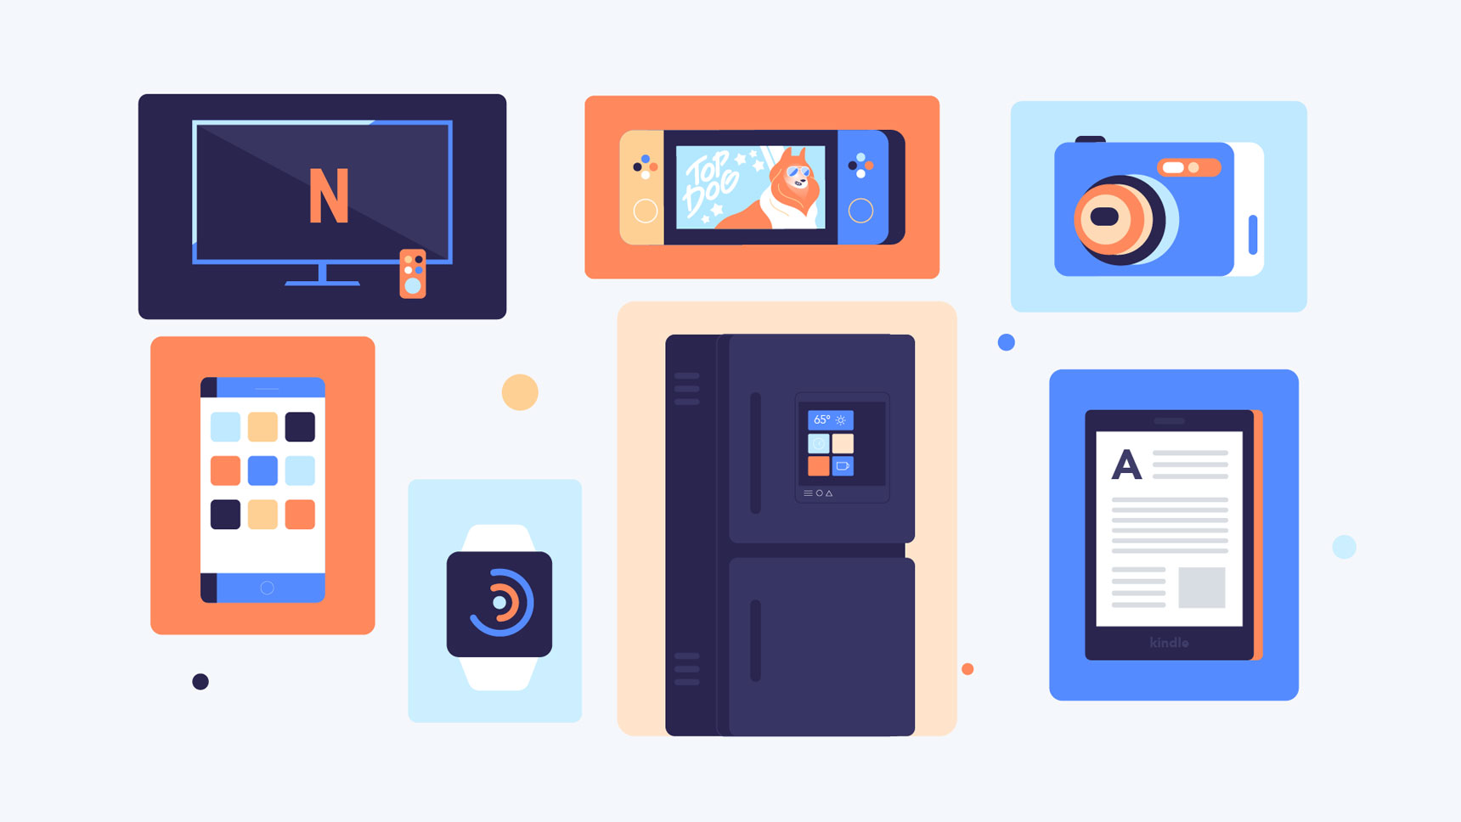
BUT THERE ARE MANY MORE TYPES:

Slide 32
HOW DO THEY WORK (BINARY SYSTEM?)
0101010001001

Slide 33
DECADE SYSTEM AND TALLY MARKS SYSTEM

Slide 34


Slide 35
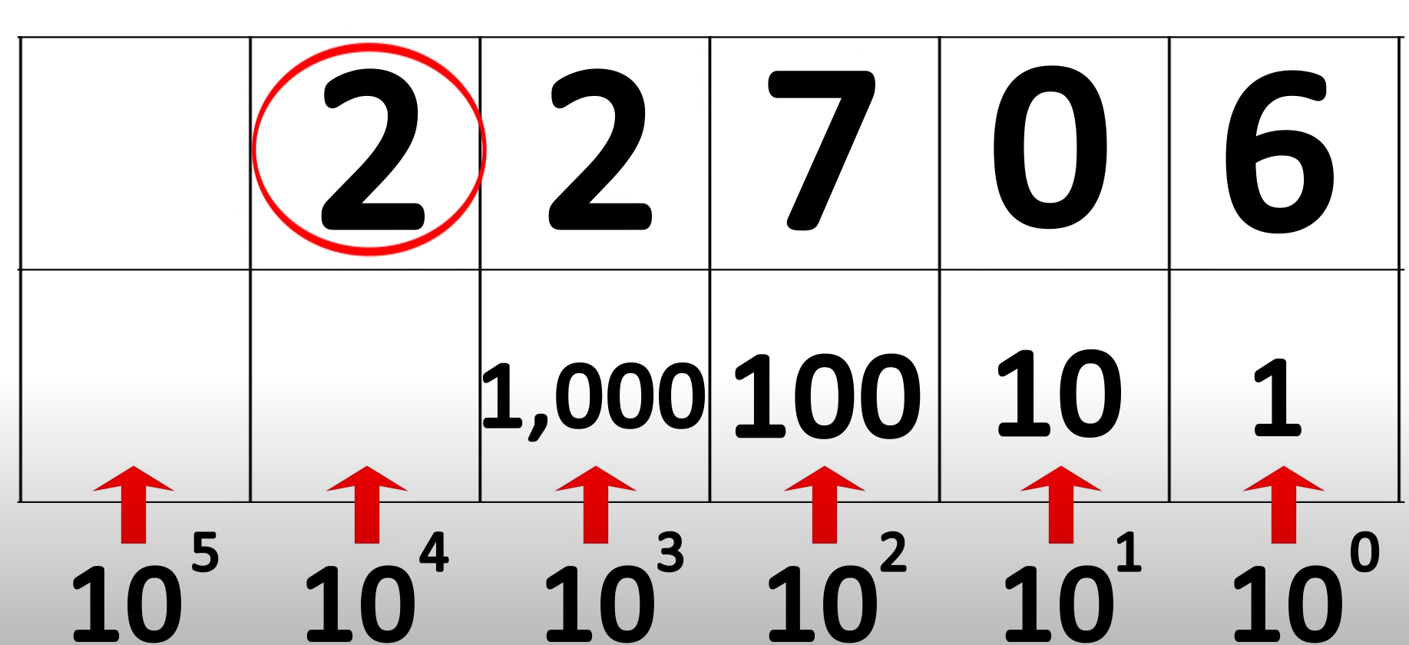

Slide 36
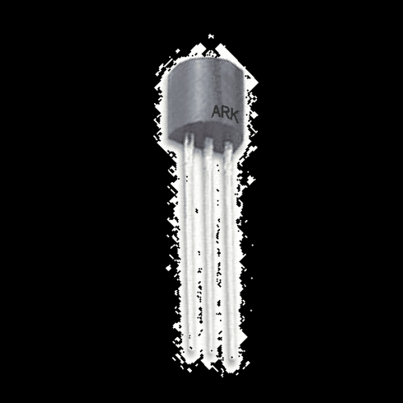
THEN WHY NOT USE THE DECADE SYSTEM:

Slide 37
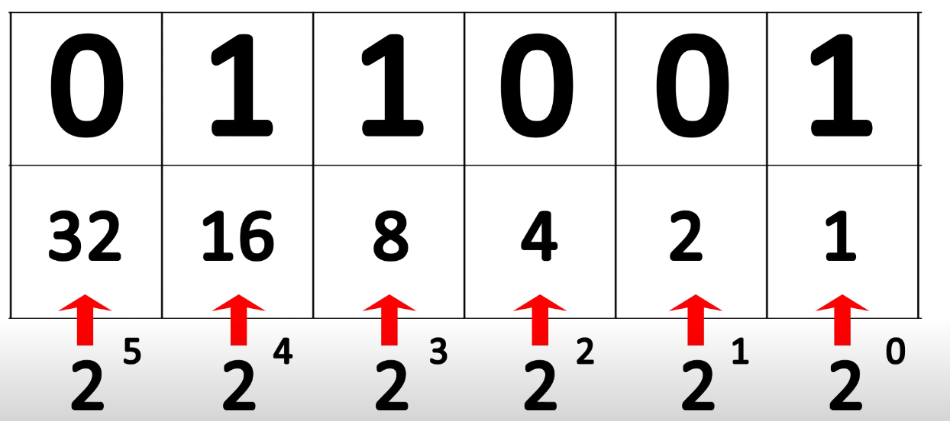

Slide 38
255

Slide 39
LETTERS? (ASCII)
AMERICAN
STANDARD
CODE
INFORAMTION
INTERCHANGE

Slide 40
01000001 (65) = ‘A’

Slide 41
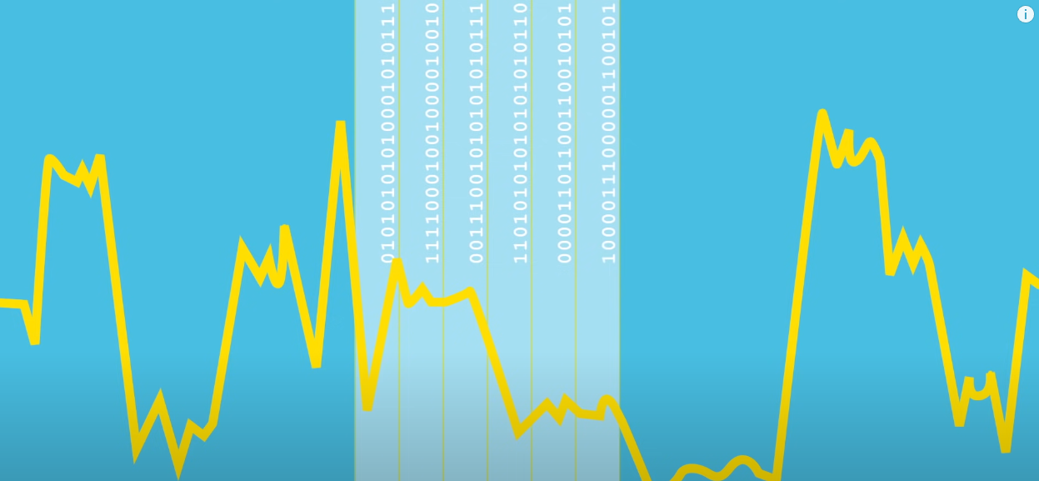
AND EVERYTHING ELSE…

Slide 42
2.OPERATING SYSTEM

Slide 43
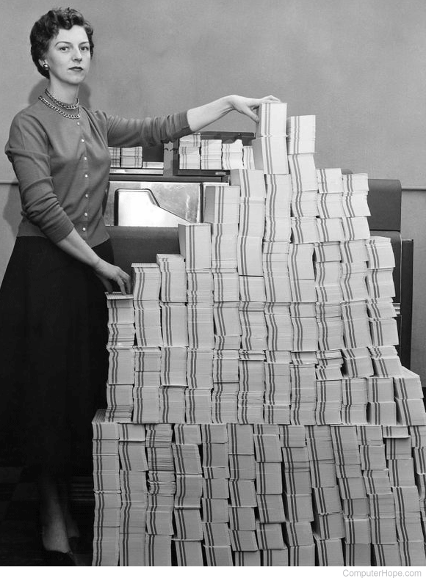
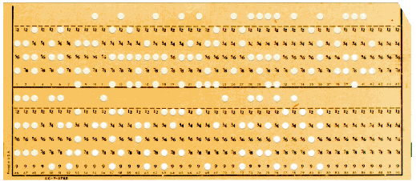
THE BEGINNING

Slide 44
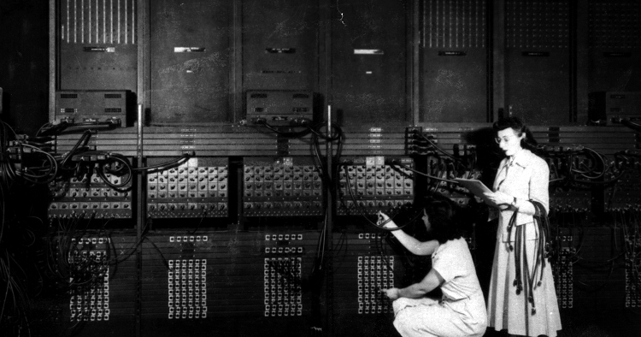
ENIAC – FIRST OS

Slide 45
MORE TYPES OF OS?

Slide 46
3.APLICATIONS

Slide 47





EVERYTHING?

Slide 48
4.OPEN SOURCE VS CLOSE SOURCE

Slide 49
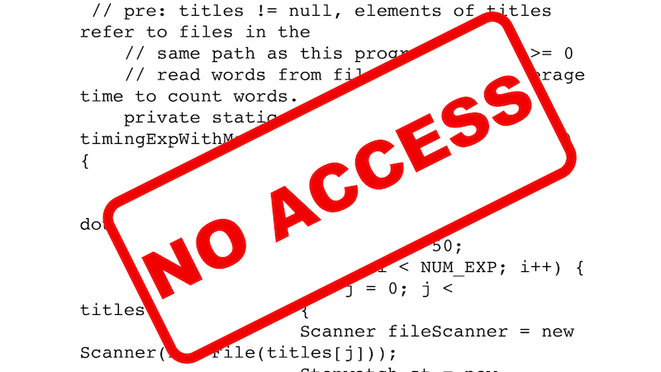
CLOSE SOURCE

Slide 50
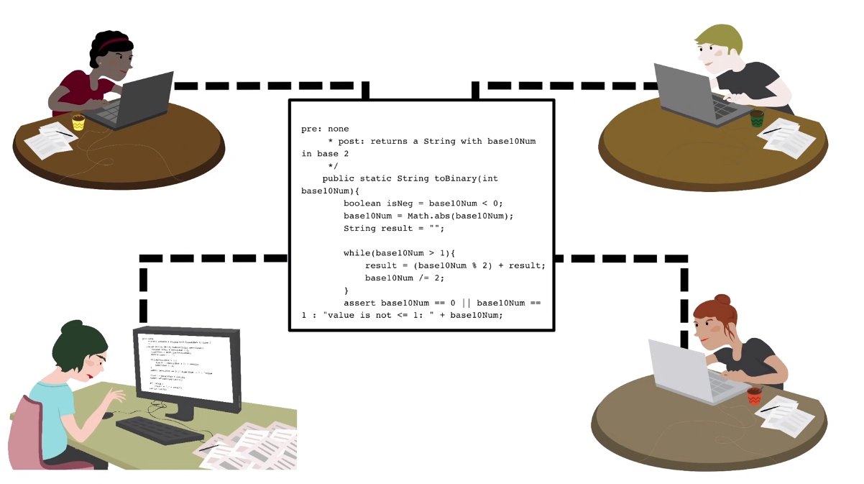
OPEN SOURCE

Slide 51
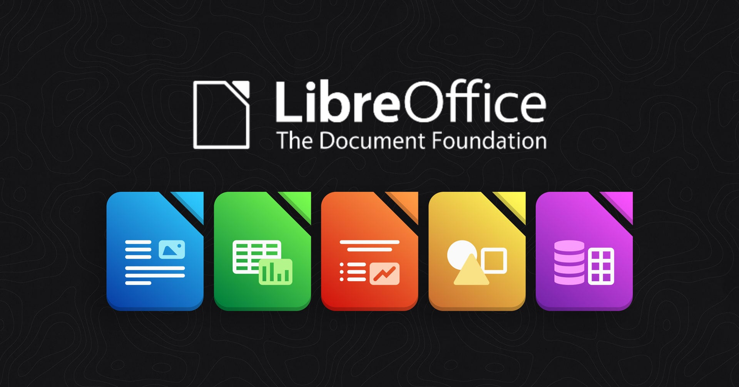
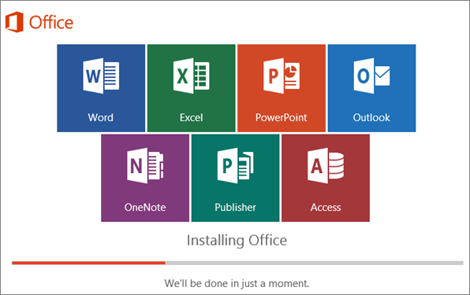

Slide 52



Slide 53

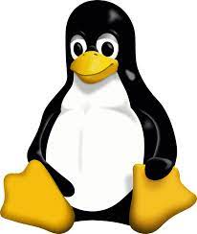

Slide 54
5.INTERNET

Slide 55
- 4,000,000 HOURS OF VIDEOS ON YOUTUBE
HOW MUCH DO WE USE THE INTERNET DAILY?
- 682,000,000 TWEETS
- 67,000,000 INSTAGRAM IMAGES
- 5,000,000,000 PEOPLE USING

Slide 56
INTERNET VS WEB?

Slide 57
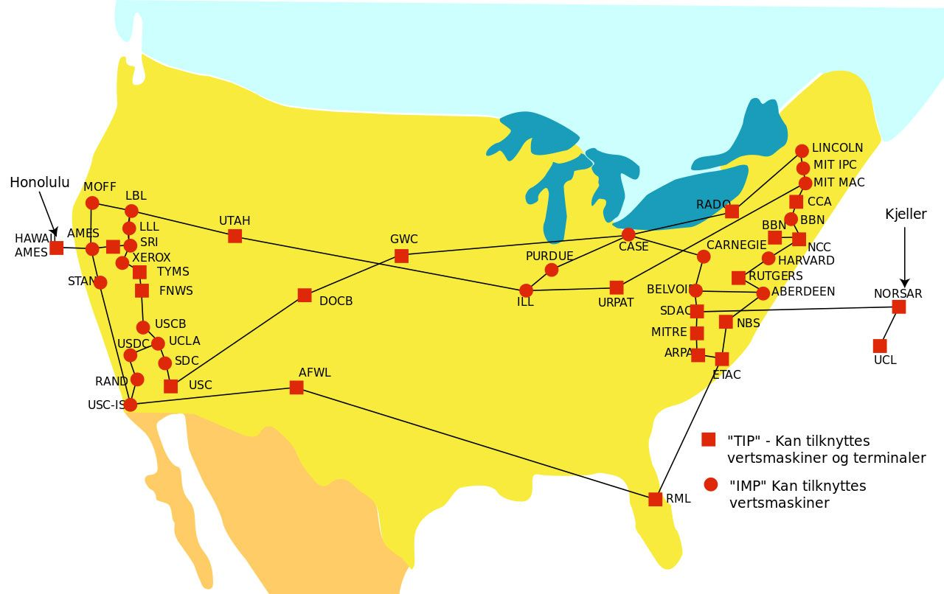
BACKGROUND – 1960. (ARPANET)

Slide 58
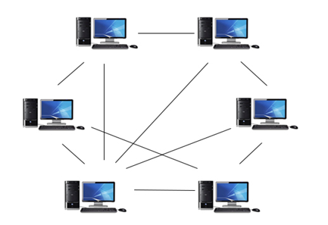
NETWORK

Slide 59
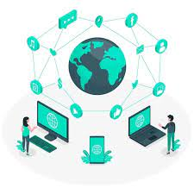
COMMUNICATING WITH THE WORLD?
INTERNET
=
INTER-NETWORK

Slide 60

HOW THE INTERNET ACTUALLY WORKS

Slide 61
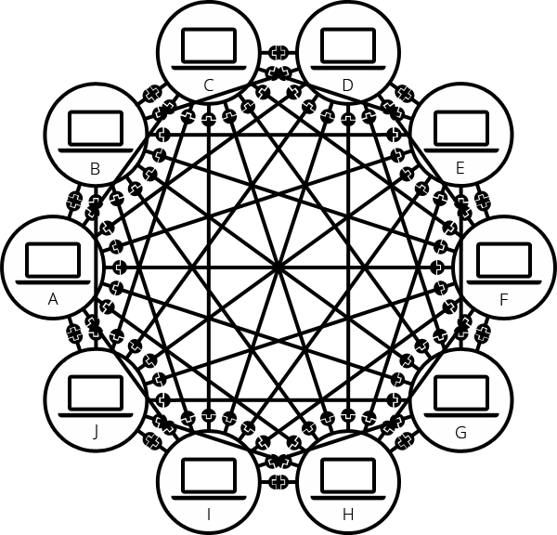

Slide 62
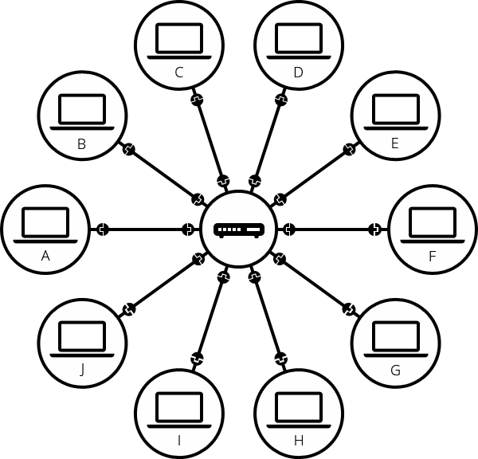

Slide 63
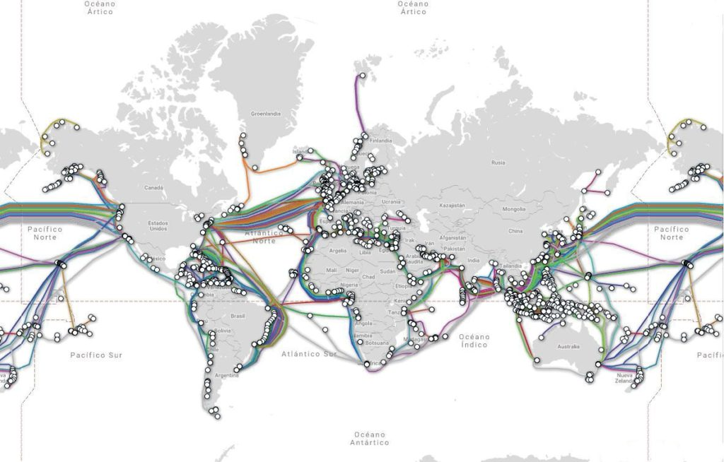
HOW FROM A ROUTER IN BIH TO ONE IN GERMANY?

Slide 64
INTERNET VS WEB?

Slide 65
INTERNET SERVICES:
- MOBILE APPLICATIONS
- INTERNET TELEPHONE (VIBER)
- ONLINE MULTIPLAYER GAMES
- WWW (World Wide Web)

Slide 66


Slide 67
WHAT HAVE WE BEEN OVER?
- COMPUTER AND HOW IT WORKS
- OPERATING SYSTEM
- APPLICATIONS
- CLOSE SOURCE I OPEN SOURCE
- INTERNET AND WORLD WIDE WEB

Slide 68
THE END ☺

